Slide 1
Variational AutoEncoders and GAN
Week 11
Ali I Ozdagli

Slide 2
Overview
Variational AutoEncoders
Basics
Hands-on Example
GAN: A brief intro

Slide 3
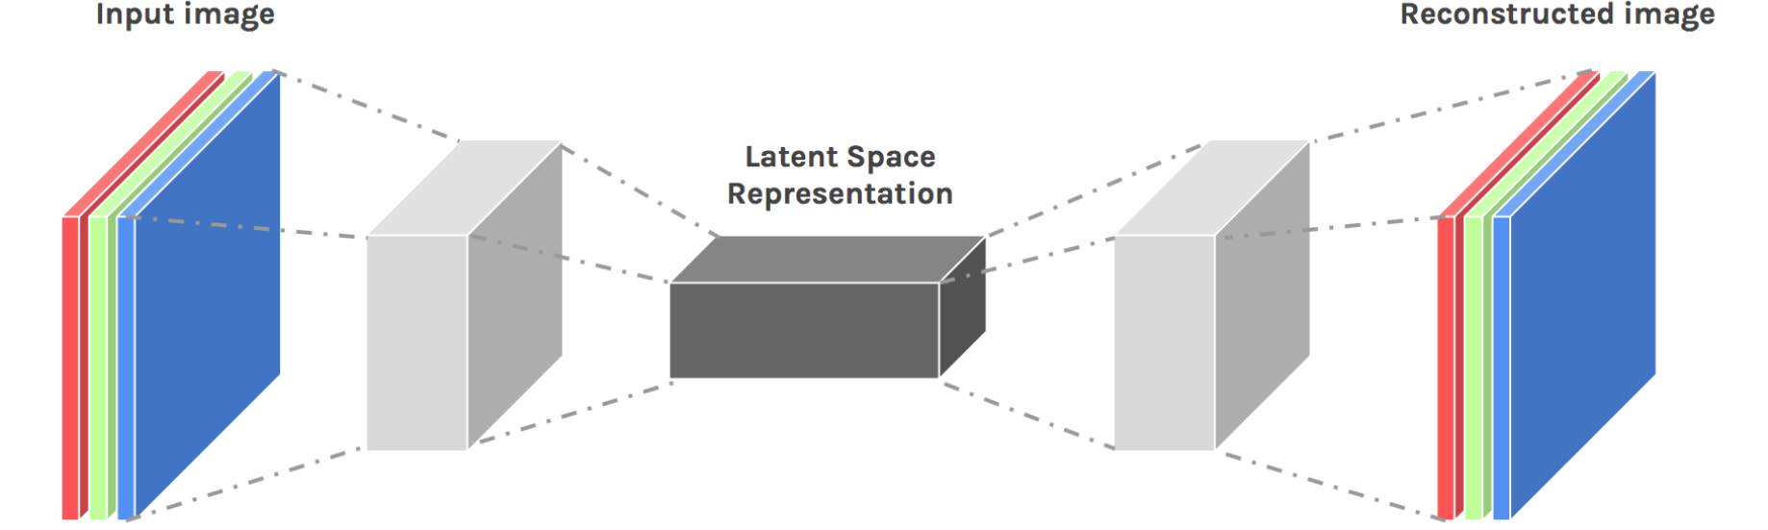
BACK To Basics
?
?
?
?
?
AE is efficient for extracting latent space representation.
Latent features are a set of weights in neurons.
Mathematically meaningless
Remember, we want to use AE for Data Generation, too.
Notes:
We want to learn latent feature space
The so called coding without supervison
THIS IS LOSSY COMPRSSION

Slide 4
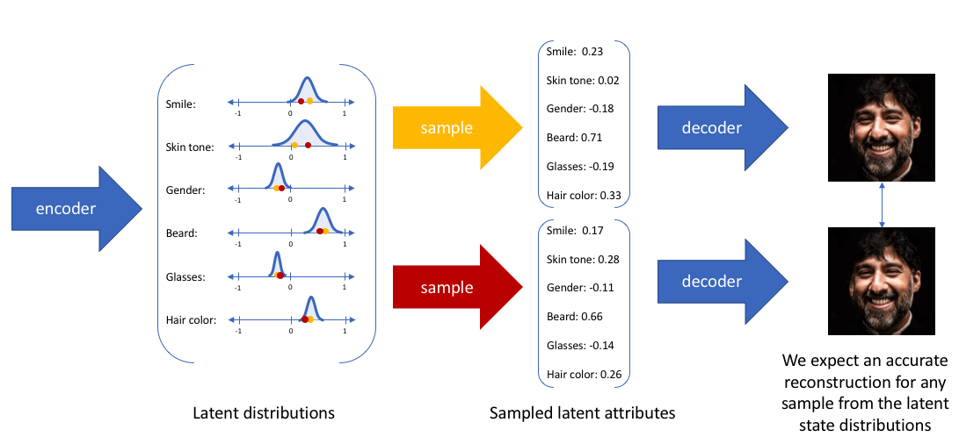
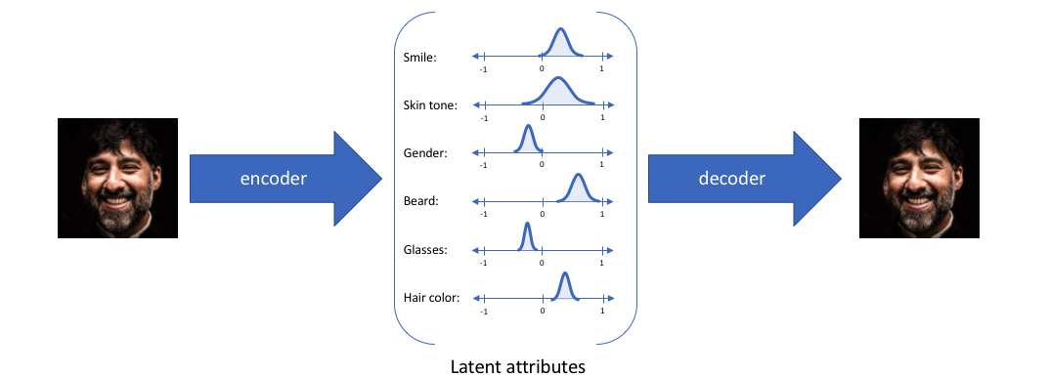
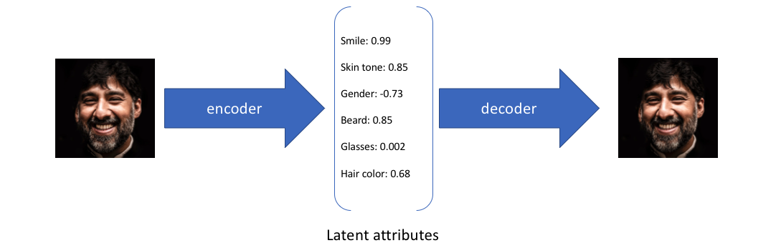
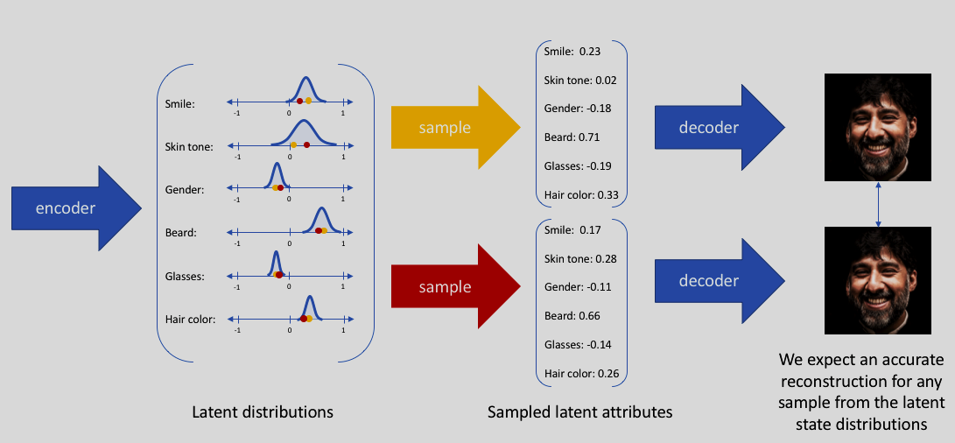
More Versality
AE
Latent features are weights
VAE
Input is encoded as distribution over latent features
Output is decoded from the encoded distribution
Less overfitting and more generalization
Enables true generative process (leading to GAN)
Notes:
When we train AE, we have encoder and decoder.
Encoder is probabilistic which is covered later.
Probability makes it more general and we can sample

Slide 5
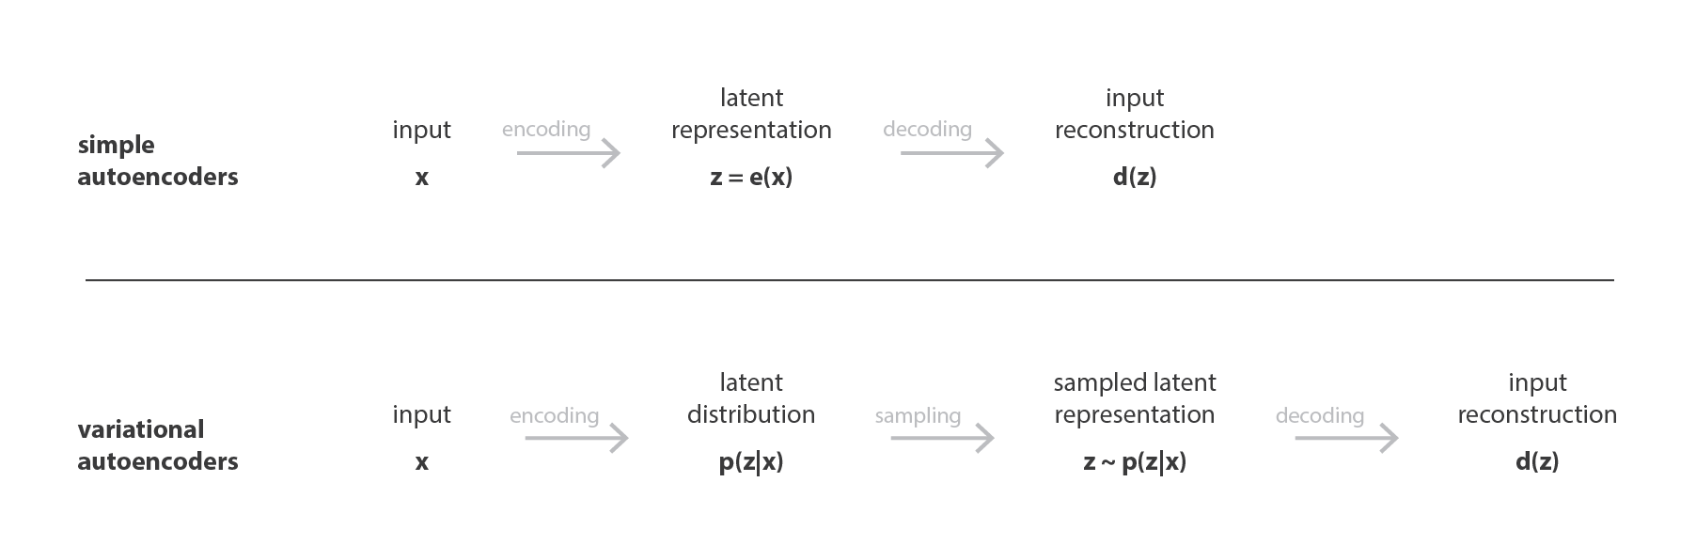
More on Comparison
AE
Latent features are weights
VAE
Input is encoded as distribution over latent features
Output is decoded from the encoded distribution
Less overfitting and more generalization
Enables true generative process (leading to GAN)
Notes:
When we train AE, we have encoder and decoder.
Encoder is probabilistic which is covered later.
Probability makes it more general and we can sample

Slide 6
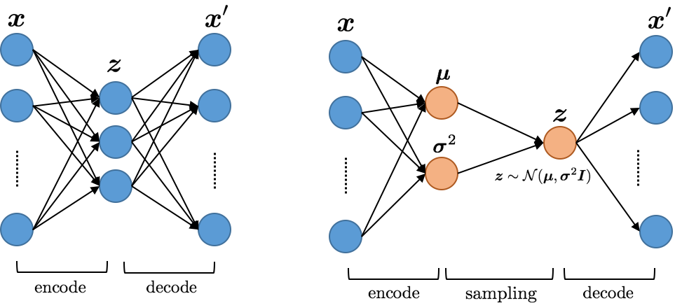
Last Step
AE
Latent features are weights
VAE
Input is encoded as distribution over latent features
Output is decoded from the encoded distribution
Less overfitting and more generalization
Enables true generative process (leading to GAN)
Notes:
Gaussian distrubiton

Slide 7
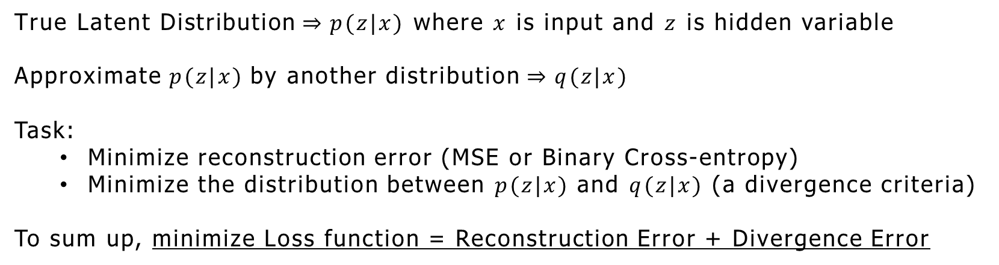
How do we train for Sampling?
posterior distribution
is
intractable
Variational Inference
Hence the name
Most used divergence criteria:
Kullback-Leibler
$\text{True} \text{Latent} \text{Distribution}⇒p(z|x)$ where $x$ is input and $z$ is hidden variable
Approximate $p(z|x)$by another distribution $⇒q(z|x)$
Task:
Minimize reconstruction error (MSE or Binary Cross-entropy)
Minimize the distribution between $p(z|x)$ and $q(z|x)$ (a divergence criteria)
To sum up, minimize Loss function = Reconstruction Error + Divergence Error
Notes:
When we train AE, we have encoder and decoder.
Encoder is probabilistic which is covered later.
Probability makes it more general and we can sample

Slide 8

HAND-ON PART AE Example
Input Dimension
784
(flattened)
Recons. Dimension
784
(flattened)
Notes:
Phi

Slide 9
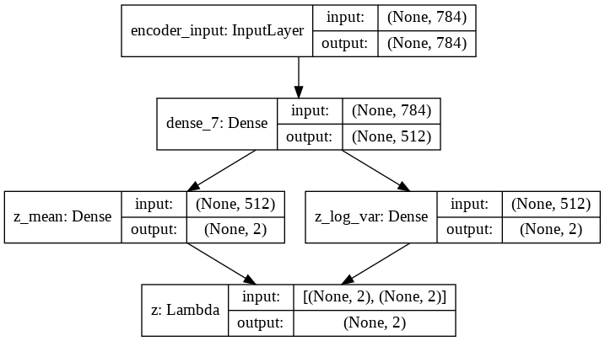
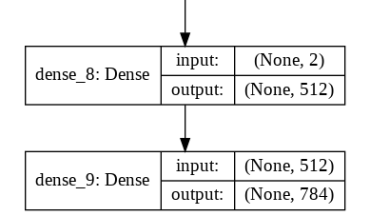
Architecture
Encoder
Sampling
Decoder
Notes:
Phi

Slide 10
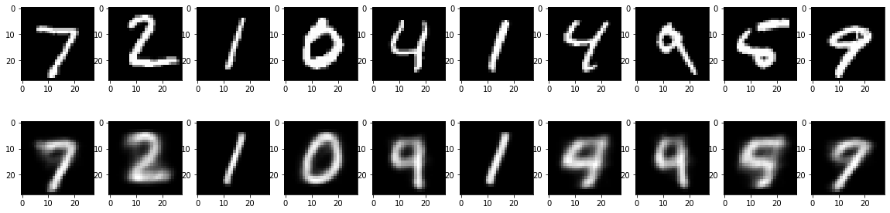
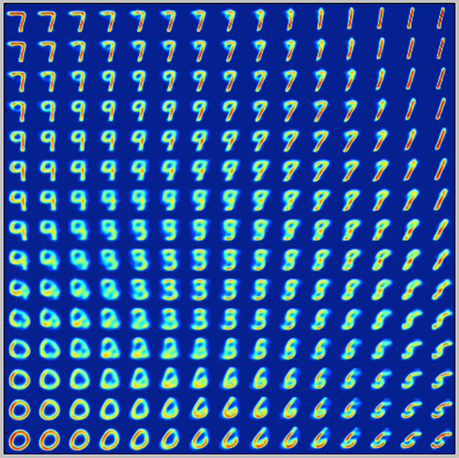
Results
Notes:
Phi

Slide 11
Brief Intro on GAN
Approach for training generative models
GAN elements
Generator: Generates new examples
Discriminator: Classifies new examples as real (from domain) vs fake (generated)
It is a two-player game
Generator player tries to generate ‘geniune’ fake examples
Discriminator tries to detect fake examples
End Goal: Generator that can create real-like examples
Notes:
Phi

Slide 12
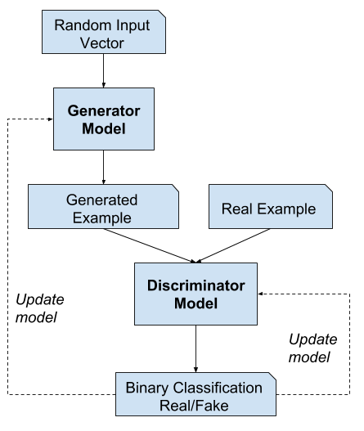
Architecture
A system that cannot be cheated
A system that can cheat
Adversarial training
Improve generalization against attacks
Resistance does not work always
Domain-specific
Notes:
Phi

Slide 13
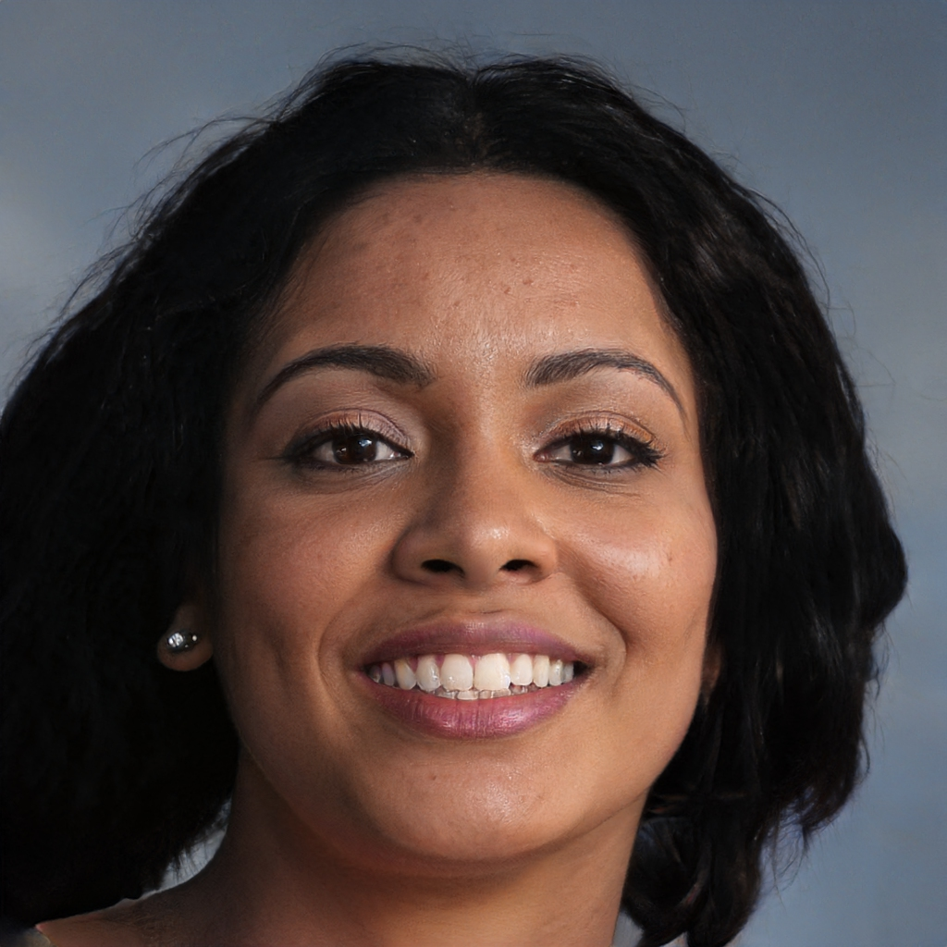

This Person Does not exist
While they look genuine to ‘human’,
Their discriminator may classify detect as fake
https://thispersondoesnotexist.com/
Notes:
Phi

Slide 14
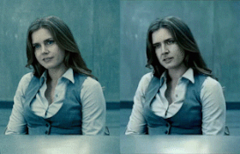
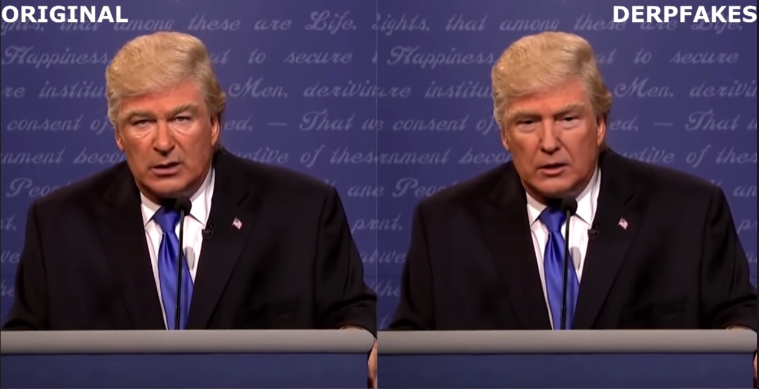
New Issues - Fakes
DeepFake
Voice cloning
https://www.resemble.ai/

Slide 15
Thank you!

Slide 16
References I USED FOR Generating VAE Slides
General
Kingma, Diederik P., and Max Welling. "Auto-encoding variational bayes." arXiv preprint arXiv:1312.6114 (2013)
Doersch, Carl. "Tutorial on variational autoencoders." arXiv preprint arXiv:1606.05908 (2016)
Basics
https://towardsdatascience.com/understanding-variational-autoencoders-vaes-f70510919f73
https://www.jeremyjordan.me/variational-autoencoders/
VAE demo
https://github.com/keras-team/keras/blob/master/examples/variational_autoencoder.py
https://wiseodd.github.io/techblog/2016/12/10/variational-autoencoder/

Slide 17
References I USED FOR GAN Slides
General
https://machinelearningmastery.com/what-are-generative-adversarial-networks-gans/
https://towardsdatascience.com/understanding-generative-adversarial-networks-gans-cd6e4651a29
Some code pieces
https://towardsdatascience.com/writing-your-first-generative-adversarial-network-with-keras-2d16fd8d4889
https://colab.research.google.com/github/keras-team/keras-io/blob/master/examples/generative/ipynb/dcgan_overriding_train_step.ipynb

